Slide 1

Team Name : Redrob AI Ranker Elite
Team Leader Name : Zia Bhombal
Problem Statement : AI-Powered Candidate Ranking Pipeline for 100,000 Profiles

Slide 2

Solution Overview
Our proposed solution is an end-to-end Candidate Search & Ranking System powered by a hybrid neural-heuristic ranking engine. It leverages SentenceTransformer semantic vector embeddings indexed using a high-speed FAISS retrieval layer, combined with a 52-feature weighted scoring engine that evaluates career trajectory, technical capability, education relevance, platform engagement, and Redrob behavioral signals.
Unlike traditional recruitment systems that rely on rigid, error-prone keyword matching, our solution:
Employs dense vector embeddings to capture the semantic similarity between job descriptions and candidate profiles, enabling context-aware matching beyond exact keywords.
Implements career stability, role progression, and educational tier scoring to assess professional maturity and long-term growth potential.
Integrates 23 native Redrob behavioral signals and platform activity metrics to prioritize highly engaged and responsive candidates.
Features an explainability engine that generates human-readable reasoning for every shortlisted candidate, ensuring transparency and recruiter confidence in the ranking process.

Slide 3
JD Understanding & Candidate Evaluation
Our system evaluates candidate fit across the following signal dimensions:
Required and Preferred Skills: Extracted using lexical hints and contextual rules.
Experience and Seniority: Years of experience are parsed using regular expressions, while seniority is classified based on experience duration.
Professional Domain & Leadership: Identifies domain expertise, leadership context, and role-specific requirements.
Semantic Alignment (FAISS Search Score): Measures semantic similarity between candidate profile summaries and the job description (JD).
Career Progression: Evaluates career stability (tenure/stability index) and the rank/tier of previous organizations.
Technical Depth: Assesses skill rarity, total skill count, GitHub repository portfolio quality, and project recency.
Education Rank: Considers degree level, institution ranking tier, and the relevance of the academic field.
Engagement Patterns: Analyzes response velocity, profile consistency, network indicators, and behavioral signals.

Slide 4
Ranking Methodology
Hybrid Retrieval & Ranking Pipeline
We implement a hybrid retrieval-ranking pipeline using sentence-transformers/all-MiniLM-L6-v2 (384-dimensional dense vectors). Multiple signals are combined into a final score (0.0 to 1.0) using a weighted linear ensemble.
Semantic Retrieval: Query the Job Description against a 100,000-candidate FAISS index to retrieve the top K (e.g., 1,000) candidates.
Feature Engineering: Compute 52 normalized features for the retrieved candidates.
Multi-Factor Scoring: Combine semantic match, career progression, technical capability, and behavioral signals into a weighted score.
Ranking: Sort candidates and return the final Top 100 shortlist.
Score Composition:
Career Score (30%): Tenure, company tier, title progression.
Semantic Match (25%): FAISS cosine similarity.
Technical Capability (25%): GitHub metrics, skill volume, technical depth.
Engagement & Signals (20%): Redrob behavioral signals and response velocity.

Slide 5
Explainability & Data Validation
For every ranked candidate, our system generates a structured, natural-language explanation outlining their title, tenure, matching skills, and key scores (e.g., semantic match, experience fit, and behavioral fit) to provide transparent justification to recruiters.
Grounding: Explanations are deterministic and template-based, using only verified candidate attributes.
Validation: Detects profile anomalies (e.g., salary max < min, activity date before signup, missing dates).
Traceability: Every explanation maps directly to computed features from the candidate record.
Quality Flags: Appends warnings (e.g., temporal_inconsistency, salary_anomaly) and applies scoring penalties for low-quality data.

Slide 6
End-to-End Workflow
Our workflow operates in 8 sequential stages:
Stage 1: Build technical skill data dictionary.
Stage 2: Load and parse the Job Description.
Stage 3: Validate and load the 100k candidate embeddings cache.
Stage 4: Encode the Job Description using the SentenceTransformer model.
Stage 5: Load the pre-built candidate FAISS index file.
Stage 6: Perform semantic search against the FAISS index to retrieve the top 1000 candidates.
Stage 7: Stream candidates from the database and score/rank them dynamically.
Stage 8: Write the top 100 shortlisted candidates and reasoning to submission.csv.

Slide 7
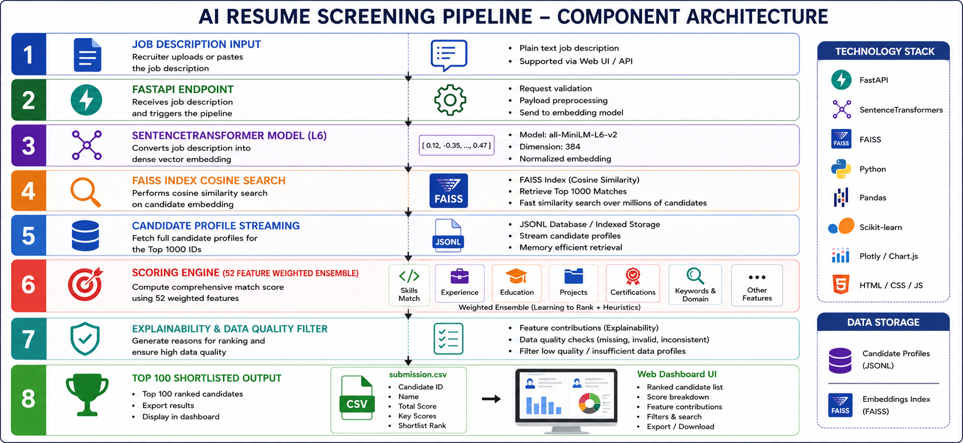
System Architecture

Slide 8
Results & Performance
Shortlist Quality: Top recommendations include stable, senior, and technically strong candidates from tier-1 companies (e.g., Yellow.ai, Meesho, Sarvam AI, Razorpay).
Rapid Search: Search, evaluation, and ranking across 100,000 candidates complete in under 3 seconds using a warm FAISS index.
Signal Alignment: Recommended candidates closely match the required skills and seniority.
Memory Efficiency: Streams candidate data from JSONL instead of loading all records into RAM, keeping memory usage below 500 MB.

Slide 9
Technologies Used
Python 3.13: Selected as the core programming language for processing and machine learning.
FastAPI & Uvicorn: A high-performance web framework to serve real-time candidate search and ranking API endpoints.
FAISS: The Facebook AI Similarity Search library, used for lightning-fast vector search over the 100,000 candidate profiles.
Sentence-Transformers (all-MiniLM-L6-v2): A highly optimized, lightweight text embedding model for semantic similarity representation.
Pytest: Professional testing framework utilized for pipeline and data quality validation.
HTML5 / CSS3 / Vanilla JS: A clean and responsive front-end dashboard with zero external library overhead to keep page load and rendering instant.

Slide 10
Submission Assets
GitHub Repository: Clean, fully refactored, production-ready code with complete unit tests.
Output Data: submission.csv containing top 100 ranked candidates with deterministic scores and reasons.
Web Video Demo: Recorded walkthrough of the interactive dashboard (dashboard_success_flow.webp).
Local Web URL: http://127.0.0.1:8000/ serving the live application.

Slide 11


